Slide 1

Consumer Goods Ad_Hoc Insights

Slide 2


ATLIQ HARDWARES
Agenda:
About AtliQ Hardware and its Business Model
Objective
Queries
Visualization
Insights & Suggestions

Slide 3
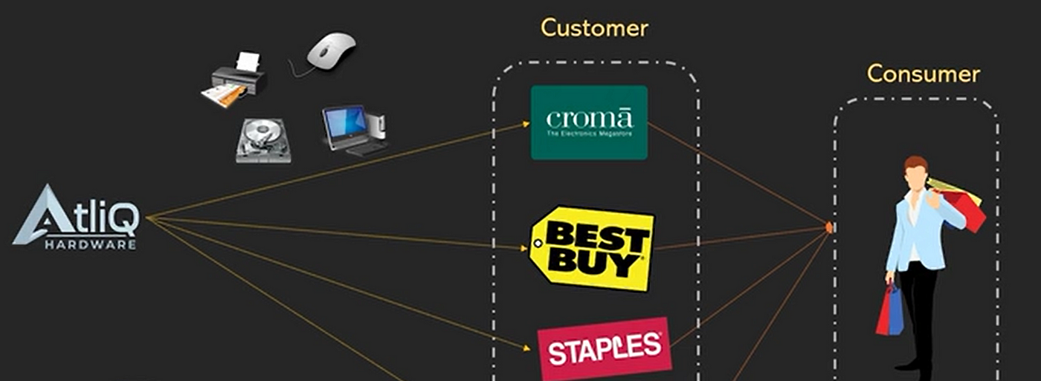
About AtliQ Hardware and its Business Model
AtliQ Hardware is a renowned global leader in electronics manufacturing, excelling in the production and distribution of a wide array of premium hardware products. Our product lineup includes personal computers, printers and various other computer peripherals, catering to the diverse needs of customers across the globe.

Slide 4
Objective
Challenge:
The executive team requires more actionable insights to enhance their decision-making process. By having timely and relevant data, they can make informed business decisions with greater speed and accuracy. This will enable them to respond more effectively to market changes and drive strategic growth.
approach:
To address this, we concentrated on:
Data Extraction: Utilizing SQL to retrieve crucial data from databases.
Data Visualization: Transforming data into clear, actionable insights.
Insights Presentation: Delivering these insights to top management to inform decision-making.

Slide 5

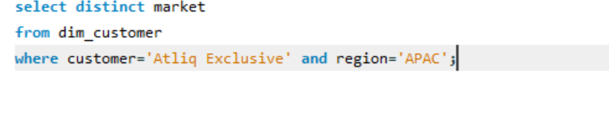
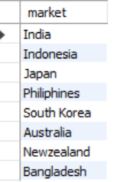
Market Presence of AtliQ Exclusive in the APAC Region

Slide 6
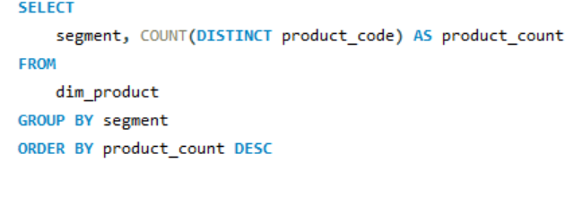
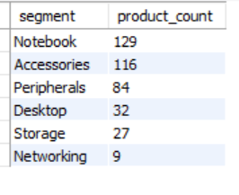
Unique Product Counts by Segment: Ranked by Highest to Lowest
Notebooks were the top sellers, while networking products had the lowest sales.

Slide 8
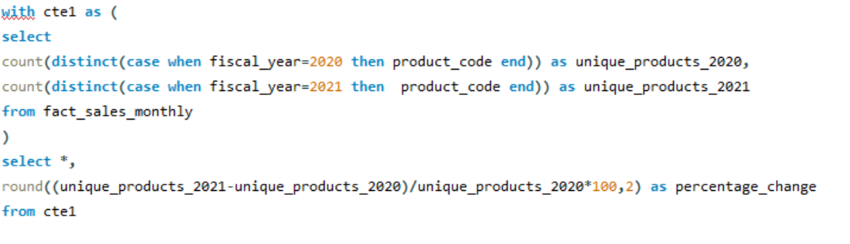

The percentage increase in unique products from 2021 to 2022

Slide 9
The percentage of unique products grew by 36.33% from 2020 to 2021.

Slide 10
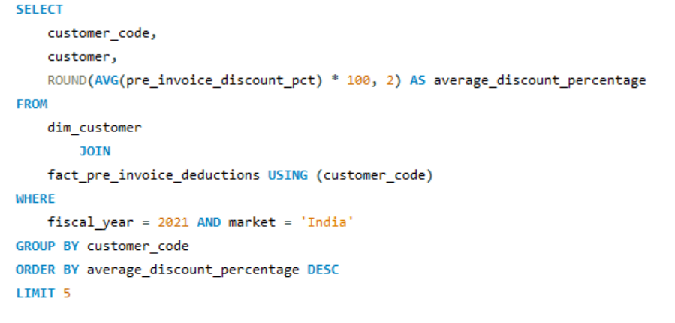
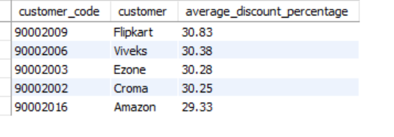
Here’s a report detailing the top 5 customers with the highest average pre-invoice discount percentage for the fiscal year 2021 in the Indian market.
Flipkart has the highest pre-invoice discount, while Amazon has the lowest

Slide 12
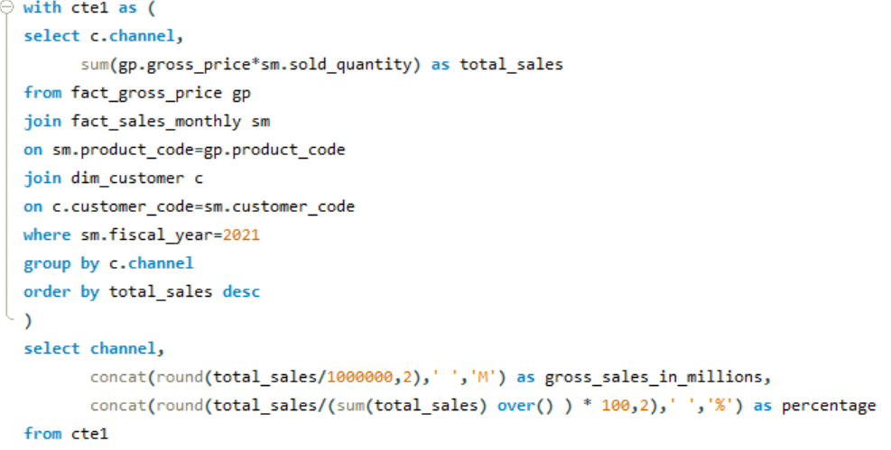
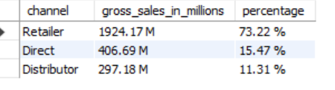
Top-Performing Channel for Gross Sales in FY 2021 and Its Contribution Percentage

Slide 14
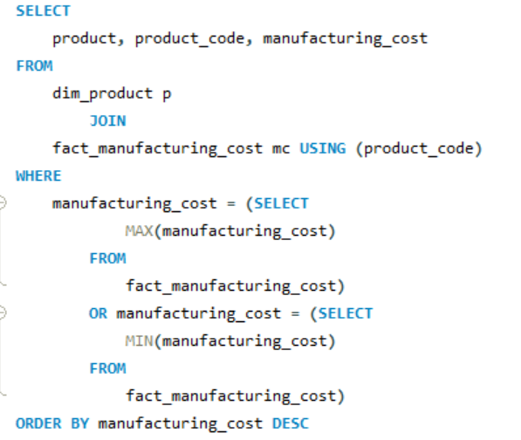
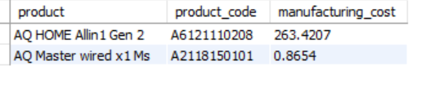
Products with Highest and Lowest Manufacturing Costs
The desktop has the highest manufacturing cost, whereas the mouse has the lowest.

Slide 15
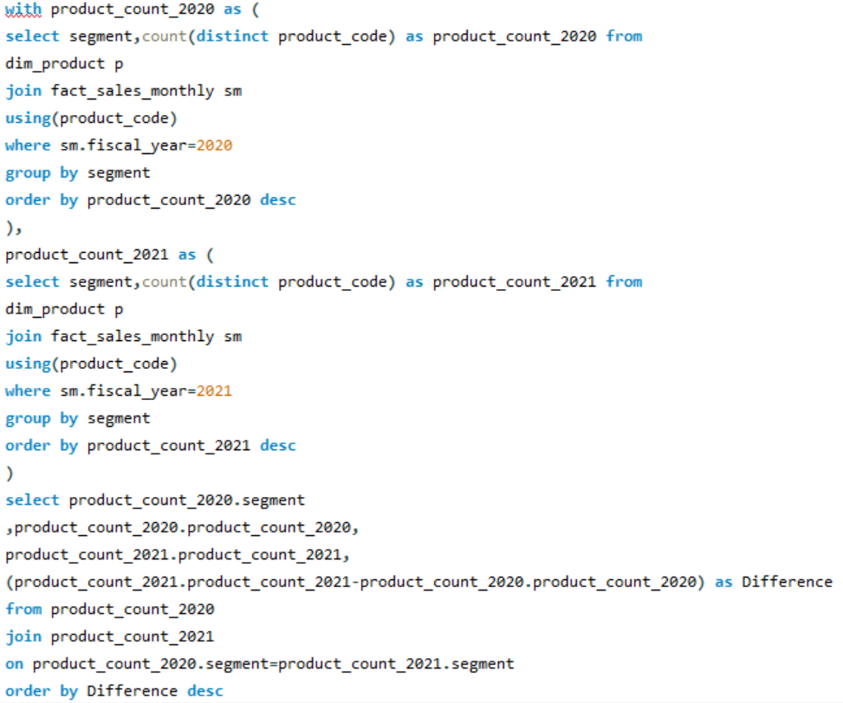
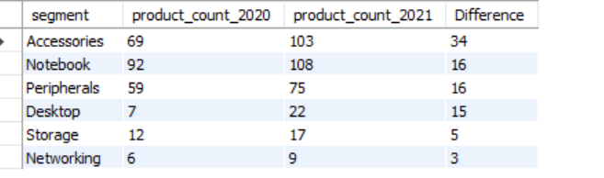
Segment Growth in Unique Products:2020-2021 Analysis

Slide 17
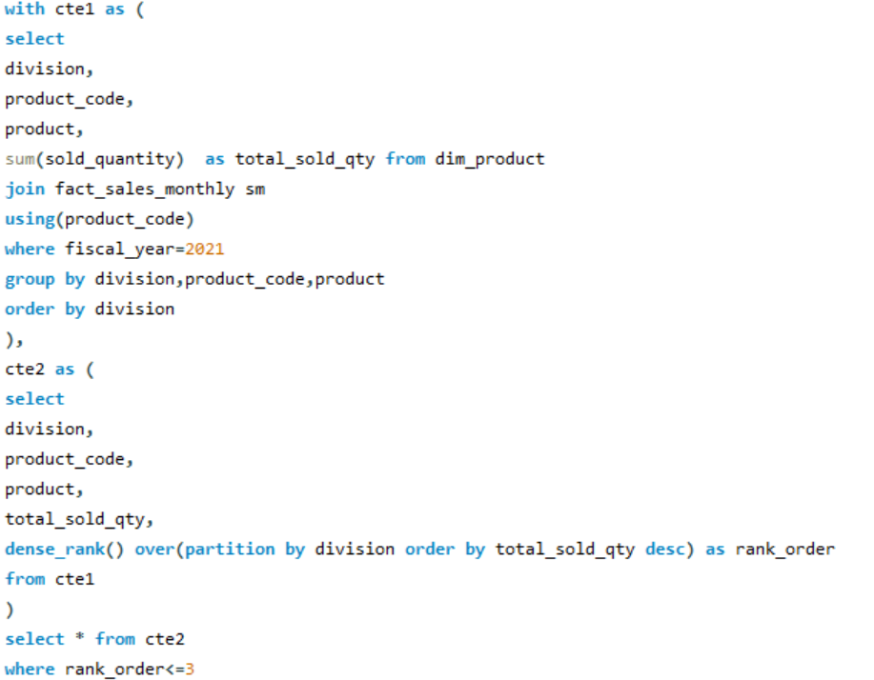
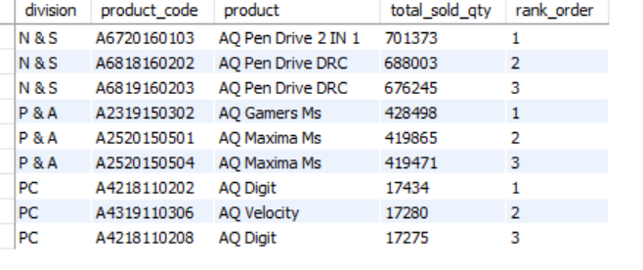
Top 3 Products by Total Sold Quantity in Each Division for FY 2021

Slide 18
Insights & Suggestions
Manufacturing Costs:
Highest: Desktops had the highest production costs.
Lowest: Mouse were the lowest production costs.
Suggestion:
Explore cost-saving measures for desktops, such as optimizing the supply chain or renegotiating supplier contracts, to improve profitability.
Product Performance:
Top Seller: Notebooks were the best-sellers.
Lowest Seller: Networking products had the lowest sales
Suggestion:
Analyze why networking products are underperforming. Consider revising the product design, enhancing marketing efforts, or exploring new features that align with customer needs.

Slide 19
Insights & Suggestions
Sales Growth:
A unique product experienced a 36.33% increase in sales during FY 2021.
Suggestion:
Investigate the factors contributing to the growth of this product. Apply successful strategies and practices to other products that are struggling to boost their sales.
Retailer Contributions:
Highest: Flipkart contributed 30.83% of customer sales.
Lowest: Amazon contributed 29.33%.
Suggestion:
Assess why Flipkart is performing better and apply similar strategies to Amazon to enhance its sales contribution. Consider promotional activities or exclusive deals with Amazon.

Slide 20
ATLIQ HARDWARES
THANK YOU!

